Slide 1
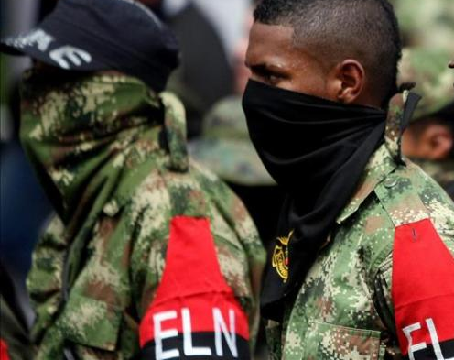
From War to Talks: influence of local negotiation tables on war related violence
Daniel Navarro

Slide 2
Context
Colombia has a problem with an ongoing rebel war and armed groups expanding their presence and violence escalating.
Current government implemented the 'Total Peace' policy, pursuing simultaneous negotiations with various armed groups.
Qualitative research concludes that the impact of these talks on local conflict dynamics is complex and heterogeneous (Johnson et al., 2025).
This research quantitatively analyzes the effect of peace talks on a wider range of conflict-related events in three municipalities to contrast results with qualitative research.

Slide 3
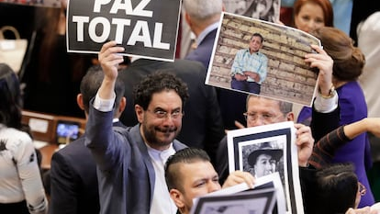
Research question:
Within Buenaventura, Arauca, and Tumaco where peace talks were initiated under Petro's 'Total Peace' policy, what is the association between the timing of those talks and the monthly incidence of conflict-related events?
Null Hypothesis (H0): The initiation of peace talks in a municipality has no statistically significant association with the monthly frequency of specific conflict-related events within that municipality.

Slide 4
Causal graph
Peace Talks
Output:
Observed War related crimes
Territorial Control
Armed group income
Clashes
Strength of local institutions

Slide 5
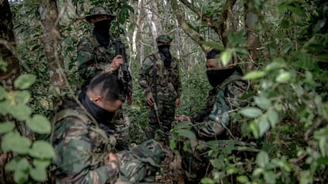
Research Design
Peace Talks are initiated from government initiative
Observed war related crimes are dependent from conflicts with other groups, fights for control and terrorism.
Clash Dummy – Ags are fighting each other

Slide 6
TWFE
$$Violence_{it}=α_{i}+λ_{t}+βTreatment_{it}+γCla{sh}_{it}+ε_{it}$$
Municipality fixed effects (alpha_i), absorbes all time-invariant characteristics including institutional quality, historical armed group presence, geography, and social structure (Arjona, 2016; Masullo, 2020)
Month fixed effects (lambda_t), absorbing all common time shocks including national policy changes, military strategy shifts, and seasonal patterns.
Time-varying controls for exogenous income shocks (global gold, oil, and cocaine prices) that affect group strength but are plausibly uncorrelated with local peace talk timing.

Slide 7
Assumptions
Strict exogeneity: the error term is uncorrelated with the entire history, present, and future of the explanatory variables.
No carryover effects: Treatment effects don't persist indefinitely in ways that bias estimates, so after removing municipality-specific intercepts and common time shocks, the remaining variation in treatment is as good as random.
Linear additive effects: The effect of treatment adds linearly to the baseline.

Slide 8
Plausibility
Strict exogeneity: Qualitative evidence shows that treatment timing is driven factors that are absorbed by fixed effects.
No carryover effects: No peace talks have concluded in a ceasefire. There should not be an effect after the treatment
Linear additive effects: Municipality and month fixed effects absorb all time-invariant municipality characteristics (institutions, geography, historical armed presence) and common time shocks.

Slide 9
Bibliography
Arjona, Ana. "Institutions, civilian resistance, and wartime social order: a process-driven natural experiment in the Colombian Civil War." Latin American Politics and Society 58, no. 3 (2016): 99-122.
Acemoglu, Daron, James A. Robinson, and Rafael J. Santos. "The monopoly of violence: Evidence from Colombia." Journal of the European Economic Association 11, no. s1 (2013): 5-44.
Mauricio, Romero. Paramilitares y autodefensas 1982-2003. Bogotá: Editorial Planeta SA (2003).
Krakowski, Krzysztof. "Colombian paramilitaries since demobilization: Between state crackdown and increased violence." Latin American Politics and Society 57, no. 4 (2015): 28-50.
Pécaut, Daniel. "Las FARC: fuentes de su longevidad y de la conservación de su cohesión.“ Análisis político 63 (2008): 22-50.
Aguilera Peña, Mario. "ELN: entre las armas y la política." IEPRI Nuestra Guerra Sin Nombre. Transformaciones del conflicto en Colombia. Bogotá: Editorial Norma (2006).
Steele, Abbey. "Electing Displacement: Political Cleansing in Apartadó, Colombia." Journal of Conflict Resolution 55, no. 3 (2011): 423-445.
Grajales, Jacobo. "The rifle and the title: paramilitary violence, land grab and land control in Colombia." Journal of Peasant Studies 38, no. 4 (2011): 771-792.
Rettberg, Angelika, and Juan Felipe Ortiz-Riomalo. "Golden opportunity, or a new twist on the resource–conflict relationship: Links between the drug trade and illegal gold mining in Colombia." World Development 84 (2016): 82-96.
Engel, Stefanie, and Ana María Ibáñez. "Displacement Due to Violence in Colombia: A Household-Level Analysis." Economic Development and Cultural Change 55, no. 2 (2007): 335-365.
Moreno León, Carlos Enrique. "Chronicle of a Survival Foretold: How Protest Behavior Against Armed Actors Influenced Violence in the Colombian Civil War, 1988–2005." Latin American Politics and Society 59, no. 4 (2017): 3-25.
Masullo, Juan. "Civilian Contention in Civil War: How Ideational Factors Shape Community Responses to Armed Groups." Comparative Political Studies (2020): 0010414020912285.
Prieto, Juan Diego. "Together after war while the war goes on: Victims, ex-combatants and communities in three Colombian cities." International Journal of Transitional Justice 6, no. 3 (2012): 525-546.
Peña, Andrea González, and Han Dorussen. "The reintegration of ex-combatants and post-conflict violence. An analysis of municipal crime levels in Colombia." Conflict Management and Peace Science (2020): 0738894219894701.
Rettberg, Angelika. "The private sector and peace in El Salvador, Guatemala, and Colombia." Journal of Latin American Studies 39, no. 03 (2007): 463-494.
Zuluaga Nieto, Jaime. “De Guerrillas a Movimientos Políticos: Análisis de la Experiencia Colombiana, el caso del M-19. En Peñaranda y Guerrero Barón (ed.), De las Armas a la Política (1-74), Bogotá: Tercer Mundo Editores (1999).
Botero, Sandra. "Trust in Colombia’s Justicia Especial Para La Paz: Experimental Evidence.“ Journal of Politics in Latin America 12, no. 3 (2020): 300-322.
Johnson, K., Botero, F., Botero, M., Aponte, A., and Asprilla, L., (2025) Política de Paz Total: Entre luces y sombras: Marco para analizar la política integral de construcción de paz de Colombia. SOC ACE Documento de investigación 34. Universidad de Birmingham.

